Slide 1
WP5: Disability Awareness of health professionals
Prof. Alexios Benos Assistant Prof. Emmanouil Smyrnakis
27/06/2018 2nd meeting of SMiLe project

Slide 2
Contents of the presentation
SMiLe Work Package 5: - Disability Awareness of health professionals - WP5 Deliverables
Presentation of Laboratory of Primary Health Care, General Practice and Health Services Research.
27/06/2018
2nd meeting of SMiLe project

Slide 3
Laboratory of Primary Health Care, General Practice and Health Services Research.
Main fields of expertise:
Primary Health Care and General Practice
Public Health
Health Policy
27/06/2018
2nd meeting of SMiLe project

Slide 4
SMiLe Work Package 5
27/06/2018 2nd meeting of SMiLe project

Slide 5
Disability Awareness of health professionals
Attitudes of the nursing and healthcare staff can create major barriers to healthcare for persons with disabilities (Sharby, Martire et Iversen, 2015).
There is a paucity of literature on knowledge, attitudes, behaviour and education of healthcare professionals concerning disability issues in Greece and Bulgaria.
27/06/2018 2nd meeting of SMiLe project
Notes:
Όσο έψαξα δεν βρήκα τίποτα για Βουλγαρία. Νομίζω όμως ότι πρέπει να την προσθέσουμε εδώ.

Slide 6
Disability Awareness of health professionals
The existing studies highlight both the lack of relevant knowledge, education and the poor attitudes of students and health care professionals towards adults and children with disabilities (Kritsotakis et al., 2017; Matziou et al., 2009; Velonaki et al., 2015).
27/06/2018 2nd meeting of SMiLe project

Slide 7
The SMiLe project’s WP5
The main aim of our project is the development of an educational program focusing on disability issues for Primary Health Care Practitioners (PHCP) in order to overcome discriminations faced by disabled persons.
27/06/2018 2nd meeting of SMiLe project

Slide 8
The SMiLe project’s WP5
Our objective is:
To offer PHCP the opportunity to improve knowledge on particular needs of disabled persons (visual, hearing, mobility).
To enhance the practitioners’ communication skills focusing on the specific needs of each disability.
27/06/2018 2nd meeting of SMiLe project

Slide 9
The SMiLe project’s WP5
D. 5.2. Joint PHC Practitioners' Training Scheme
D. 5.2.2 Training Center for PHP Practitioners
D. 5.2.3 PHC Practitioners' Training Program
D. 5.2.4 Toolbox for Equal Health Provision
WP5 end: September 2019

Slide 10
The SMiLe project’s WP5
5.1 Joint PHC Practitioners' Training Scheme
Define training coordinators
Iasmos PCH, National Emergency Center Greece Hospital of Ardino and Harmanli – Bulgary
27/06/2018 2nd meeting of SMiLe project
Notes:
National Emergency Center το βάζουμε; Προτείνω να επικεντρωθούμε στο ...
+ other PHC - Primary Health Care Teachers’ Network ?
Γνωρίζουμε ότι σε πρώτη φάση 10 τους πληρώνει η ΥΠΕ. Νομίζω ότι αυτούς πρέπει να τους βάλουμε όλους; Για αυτούς από Βουλγαρία καλύτερα να προτείνουμε συζήτηση.

Slide 11
The SMiLe project’s WP5
5.1 Joint the PHC Practitioners’ Training Scheme. Training coordinators:
Phase A.
They will be trained in our Training Center, AUTH-Thessaloniki
Phase B.
They will support the short training seminars in situ the cross border area.
27/06/2018 2nd meeting of SMiLe project

Slide 12
The SMiLe project’s WP5.1
Presentation of SMiLe project to Primary Health Care Teachers’ Network, with members from more than 120 Centers (PHC) in Greece and Cyprus.
Personal letters to health practitioners of Iasmos PHC.
Presentation of the SMiLe project in situ (Iasmos).
27/06/2018 2nd meeting of SMiLe project
27/06/2018 2nd meeting of SMiLe project

Slide 13
The SMiLe project’s WP5.1 Planning to contact
1.GR
Chryssoupoli ’s
PHC
2.BG
Ardino’s Hospital
Nea Michaniona ’s
PHC
Harmanli Hospital
Notes:
Να πούμε ότι είναι η πρότασή μας για το first pilote training program?
Μήπως εδώ πρέπει να βάλουμε τα PHC στο Νευροκόπι και το Διδυμότειχο; Πόσοι θα είναι από κάθε κέντρο υγείας; Επίσης εδώ μπορεί να μπει ερώτηση ως προς τον σχεδιασμό. Εξηγώντας ότι προβλέπεται στην Ελλάδα θα εκπαιδευτούν στο κέντρο και στην Βουλγαρία in situ...τί θεωρούμε καλύτερο για την εκπαίδευση;

Slide 14
The SMiLe project’s WP5
D 5.2.2 Training Center for PHP Practitioners
An area of AUTH Medical School is granted to INTERREG to be used as a Clinical Skills Educational Centre
New educational environment and educational material needs

Slide 15
The SMiLe project’s WP5
D 5.2.2 Training Center for PHP Practitioners

Slide 17
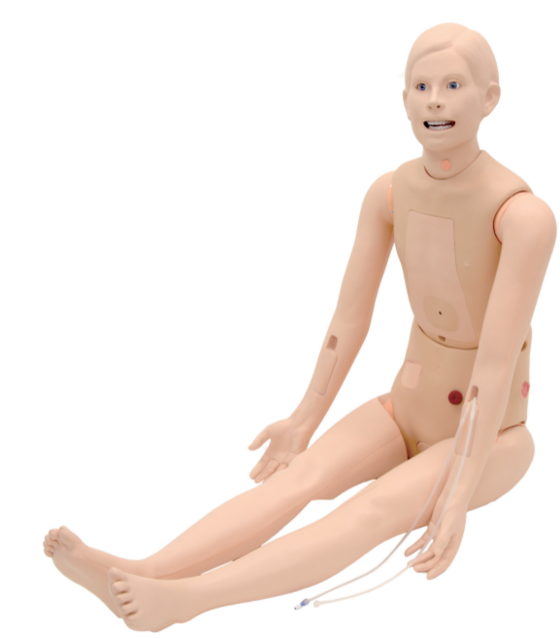
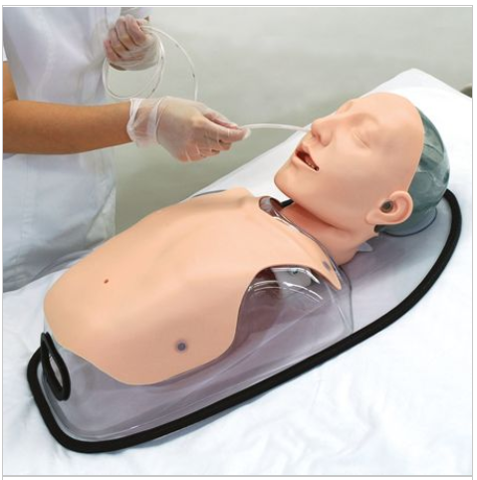
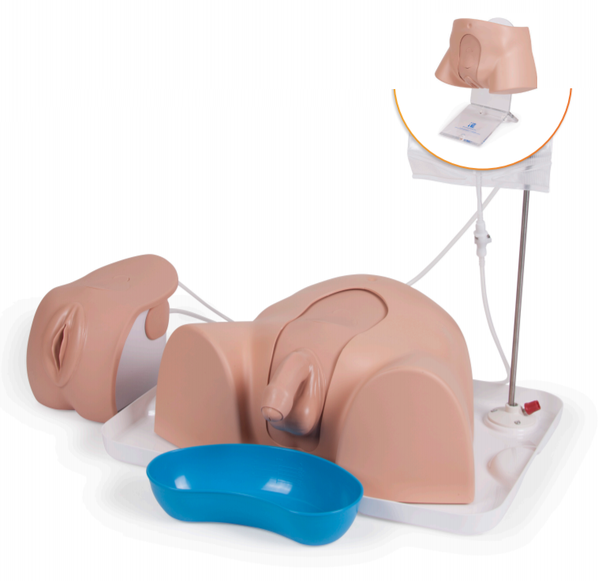
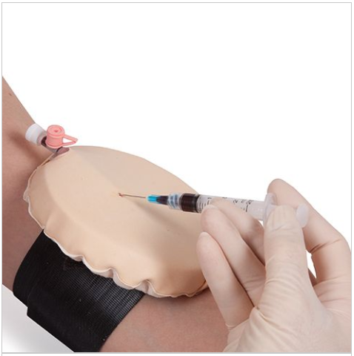
Manikins and part-task trainers available in the Educational Center

Slide 18
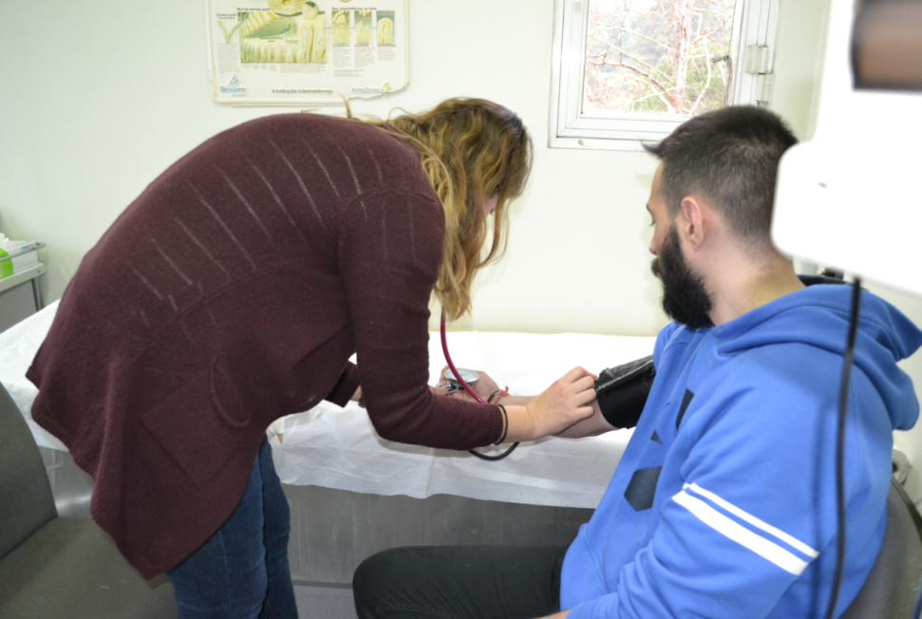
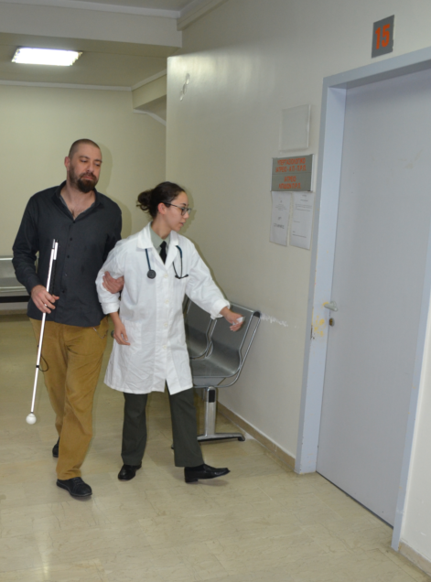

Slide 19
The SMiLe project’s WP5
D. 5.2.3 PHC Practitioners' Training Program
Equal access in Healthcare
Training on basic clinical skills
Notes:
Α. Principles and practices for supporting equal access in Healthcare
Primary Healthcare: goals, definitions, the Alma-Ata declaration. Scientific and administrative approach Alexis Benos
Designing health care services: Health needs assessment Stathis Giannakopoulos
Accessibility needs for people with disabilities in primary healthcare: stereotypes, language etiquette, obstacles Panagiotis Tsalis
Multi-professional teamwork – healthcare team Maria Moirasgenti
People with mental disorders Vangelis Zalios
Community participation in primary health care development Emmanouil Smyrnakis
Clinical workshops
Α. Feedback technique in education
Β. Developing communication skills for people with disabilities
Communicating (effectively) with visually impaired people
Communicating (effectively) with people with physical disabilities
Communicating (effectively) with hearing impaired people
Practicing basic clinical skills
Basic clinical examination of a person with a disability
Transportation of a person with a disability
Practicing basic clinical skills on people with disabilities (vital signs measurement, venepuncture, injections, bladder catheterisation, wound suturing, airway release, nasogastric tube insertion and others)

Slide 20
The SMiLe project’s WP5
D. 5.2.3 PHC Practitioners' Training Program
Qualitative Research
Educational Curriculum Improvement
Creation of new educational material
Notes:
Qualitative research on attitudes and knowledge of health practitioners towards people with disabilities. (WP4) We have already the methodology of the survey (guide of interviews). Note: P3 and P4 have the budget for a similar survey.
The results of the survey will be used in order to improve the educational curriculum. Special attention will be paid to local needs and particularities.

Slide 21
The SMiLe project’s WP5
5.2.3 PHC Practitioners’ Training Programs
1. 2-Day Training Seminars for Trainers of Health Care Units in Greece and Bulgaria
AUTH Clinical Skills Educational Center, Thessaloniki
(Month 16-18, Friday 5pm-9pm and Saturday 10am-4pm)
Notes:
1.Place: AUTH Clinical Skills Educational Center
Language: English
Participants: team of 15-20 people (participation of at least 2 persons from every selected unit from Greece and Bulgaria
2. Teaching Staff: trained instructors already having attended the AUTH Clinical Skills Educational Center
Place 1: Iasmos in Greece, Language: Greek, Participants: health care professionals of the collaborating Health Care Units (the AUTH Group also participating)
Place 2: Ardino & Zlatograd in Bulgaria, Language: Bulgarian, Participants: health care professionals of the collaborating hospitals of Ardino/Zlatograd

Slide 22
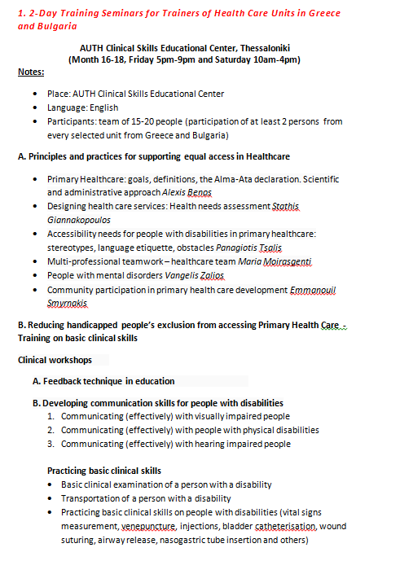

Slide 23
The SMiLe project’s WP5
5.2.3 PHC Practitioners’ Training Programs
2. Training Seminar for Health Care Professionals in Local Health Units
Ardino, Haskovo Hospital and Iasmos Health Center
(Month 18, Friday 9am-2pm)
Notes:
1.Place: AUTH Clinical Skills Educational Center
Language: English
Participants: team of 15-20 people (participation of at least 2 persons from every selected unit from Greece and Bulgaria
2. Teaching Staff: trained instructors already having attended the AUTH Clinical Skills Educational Center
Place 1: Iasmos in Greece, Language: Greek, Participants: health care professionals of the collaborating Health Care Units (the AUTH Group also participating)
Place 2: Ardino & Zlatograd in Bulgaria, Language: Bulgarian, Participants: health care professionals of the collaborating hospitals of Ardino/Zlatograd

Slide 24
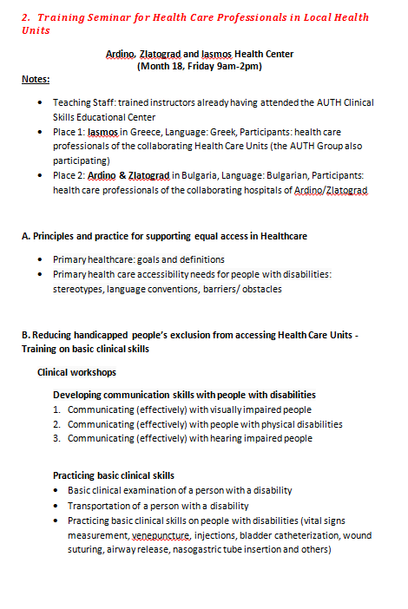

Slide 25
The SMiLe project’s WP5
5.2.4 Toolbox for Equal Health Provision
Recommendations and guidelines on how to foster access to primary health care will be developed.
Online, as part of project’s webside
Synthesis of the whole project
Outputs to define the future «model» strategy plans for the sector

Slide 26
The SMiLe project’s WP5
5.2.4 Toolbox for Equal Health Provision
Recommendations for modification/ improvement of standard policies and procedures
Basic principles for health care practitioners on interaction with persons with restricted mobility
Basic guidelines on creating accessible infrastructure as well as how to assess this infrastructure
Basic guidelines on the selection of accessible equipment

Slide 27
Next Steps
Finalize the list of training coordinators
Recruitment of PHC Staff in emergency and PHC services in the cross-border area (Ardino, Haskovo and Iasmos Health Center)
Finalize educational program
Design - Reconstruction of the Medical School space for the Clinical Skills Educational Center
Οrdering equipment

