Slide 1
WP4: Studies to improve PHC services in CB area
Dr. Panagiotis Tsalis
Transport Systems Research Group, Aristotle University of Thessaloniki
TSRG/ AUTh

Slide 2
Contents of the presentation
Presentation of TSRG/ AUTh
Selected projects of TSRG/ AUTh related to accessibility
SMiLe Work Package 4
Inequalities in PHC provision
WP4 deliverables

Slide 3
The Transport Systems Research Group
The Transport Systems Research Group of the Aristotle University of Thessaloniki (TSRG/AUTh) was established by in 1998.
Functions within the Division of Transport and Project Management of the School of Civil Engineering of the Aristotle University of Thessaloniki.
The scientific activities of the Group fall under the areas of operation, planning organization and management as well as the impact of Transport Systems on people, environment, sustainable development.

Slide 4
The Transport Systems Research Group
Main fields of expertise:
Design, planning and management of Transport systems.
People with reduced mobility (disabled, elderly, etc.) and accessibility.
Urban and rural public transport and flexible transport services.
Freight transport and logistics.
Feasibility, traffic and mobility studies.
Social impact analysis on Transport systems.
Environmental management of Transport systems.
New technologies and telematics in Transport.
Transport Safety.
Tourism and Transport.

Slide 5
SMiLe Work Package 4

Slide 6
Inequalities in PHC provision
Barriers related to health for general population tend to be exacerbated for people with disabilities. Peters et al. (2008) describe four main dimensions:
Geographical accessibility
Availability, having the right type of care to those who need it
Financial accessibility
Acceptability, the match between how responsive health service providers are to the expectations of individual users.

Slide 7
The SMiLe project’s WP4
WP4, aspires to provide an in depth view of the existing situation and initiate actions for the improvement of the accessibility offered by Primary Health Care centres.
WP 4 will be based on existing methodologies developed by AUTh in the frame of research projects, research in relevant bibliography, as well as the continuous application of a version of “Delphi method” through the cooperation of the project team with involved actors, experts and citizens with disabilities.

Slide 8
The SMiLe project’s WP4
D 4.1 Constraints' analysis to access PHC
D4.2 Primary Health Care infrastructure accessibility assessment
D4.3 Pilot accessibility improvement studies
- WP4 end: 11th of October 2019

Slide 9
The SMiLe project’s WP4
In D4.1 the obstacles that citizens with disabilities face in health provision will be examined.
review of the published literature and reports
identification of existing data and legislation concerning heath care provision
assessment of policies and analysis of disparities in health care provision.

Slide 10
The SMiLe project’s WP4
In D.4.2 the accessibility of the infrastructure offered will be assessed through a specialized methodology which will be developed
The methodology will include checklists for various elements of PHC infrastructure.
The analytical nature of the methodology will ensure that it can be used in the future by non-specialized personnel, thus providing interested stakeholders with a useful tool in order to self- assess their infrastructures and services.
The methodology developed will be utilized in the evaluation of local infrastructure in Greece as well as in Bulgaria.

Slide 11
The SMiLe project’s WP4
In D4.3, a study for accessibility improvement of a major infrastructure of the area will be conducted.
The infrastructure to be selected will focus on the provision of Primary Health Care, probably in a rural area.

Slide 12
Accessibility evaluation of Iasmos PHC
Iasmos is a town and a municipality in the Rhodope regional unit of Thrace, Greece, built on the side of the Rhodope Mountains.
The municipality Iasmos was formed at the 2011 local government reform by the merger of the following 3 former municipalities, that became municipal units (Amaxades, Iasmos, Sostis)
The municipality has an area of 485.285 km2, the municipal unit 221.795 km2

Slide 13
Accessibility evaluation of Iasmos PHC
Methodology
The methodology includes the following checklists:
• Checklist for buildings – closed spaces
• Checklist for open spaces and pedestrian routes
• Checklist for health care provision practices and policies
The checklists are quite detailed and include questions that can be easily answered by the PHC centres’ employers. Thus, the proposed methodology is a necessary and useful tool for future assessment of infrastructure and policies

Slide 14
Accessibility evaluation of Iasmos PHC

Slide 15
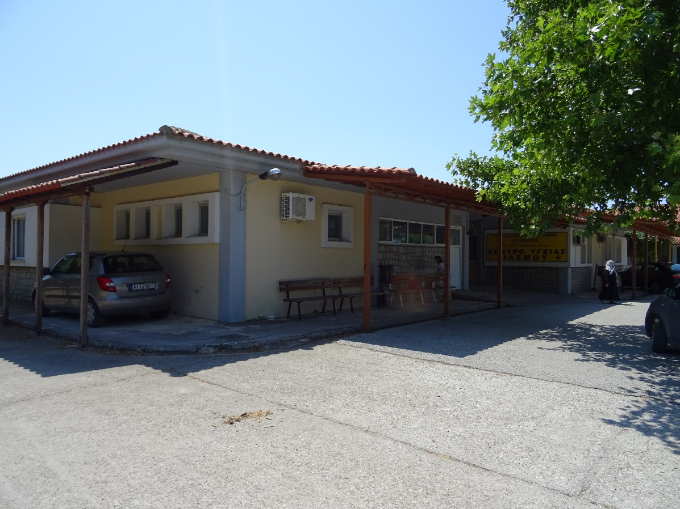
Accessibility evaluation of Iasmos PHC

Slide 16
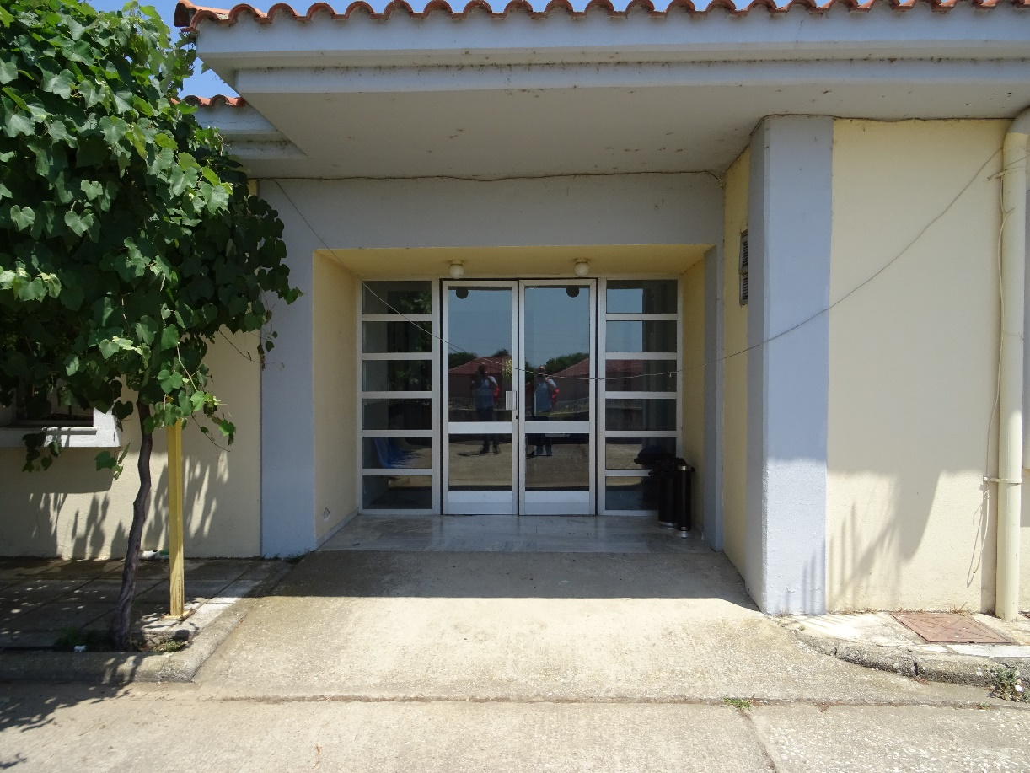
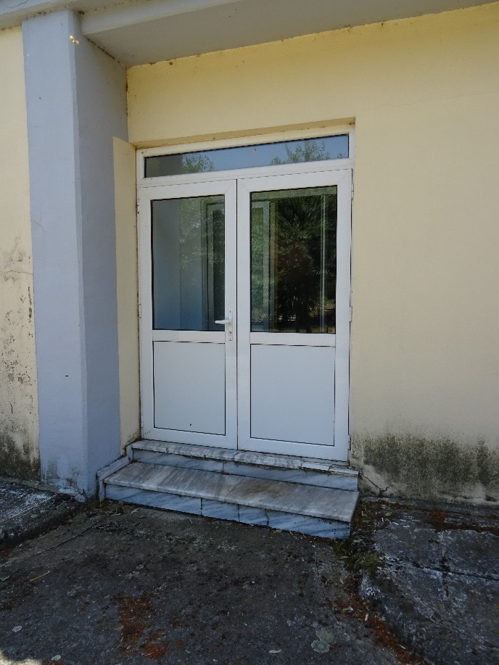
Accessibility evaluation of Iasmos PHC

Slide 17
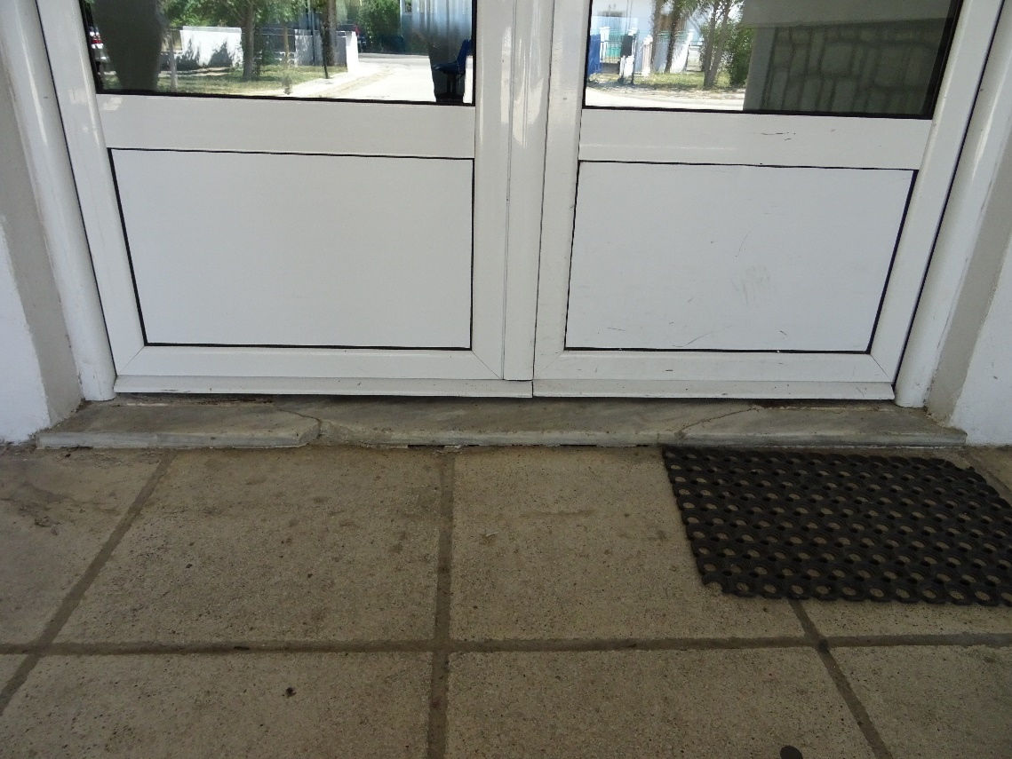
Accessibility evaluation of Iasmos PHC

Slide 18
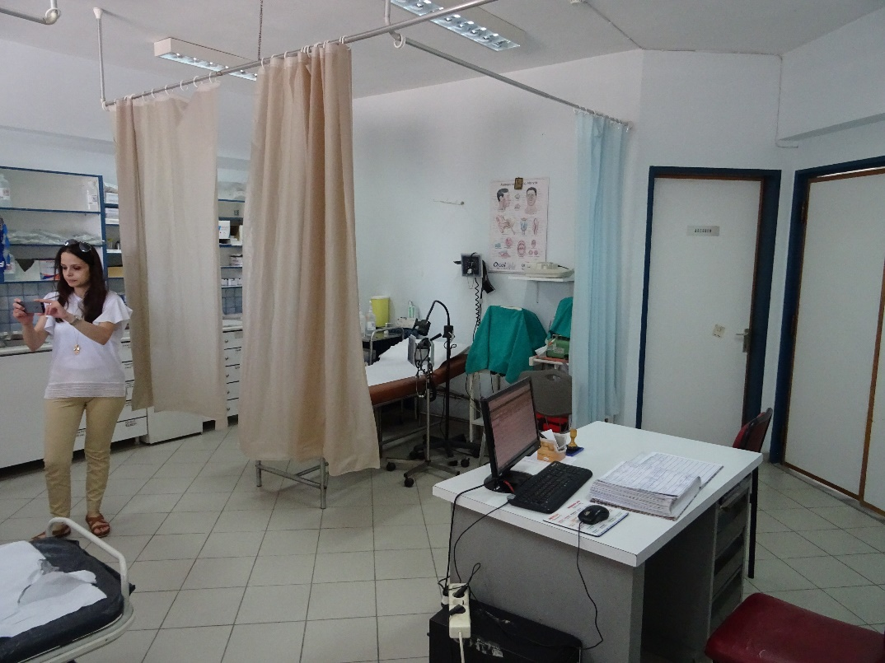
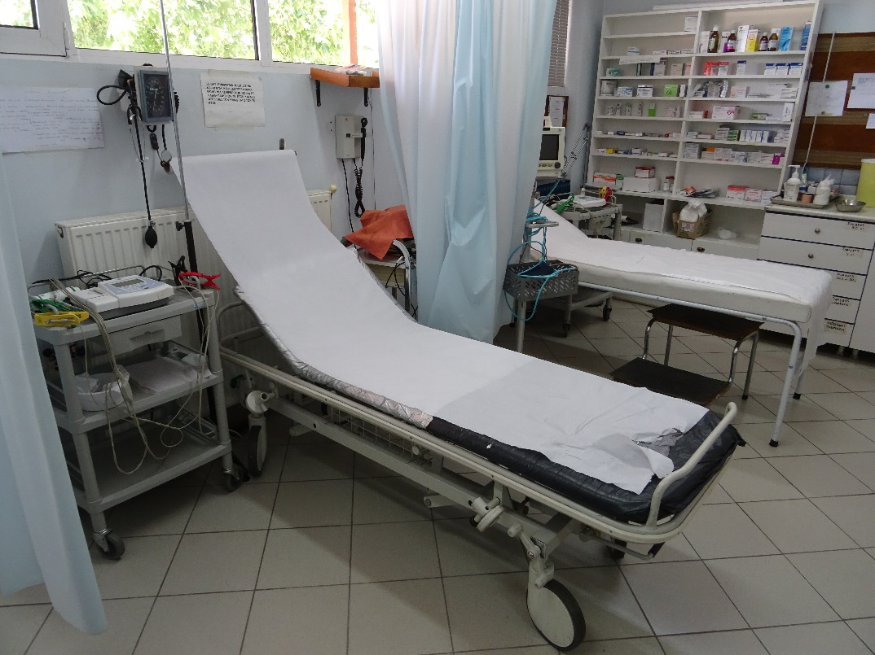
Accessibility evaluation of Iasmos PHC

Slide 19
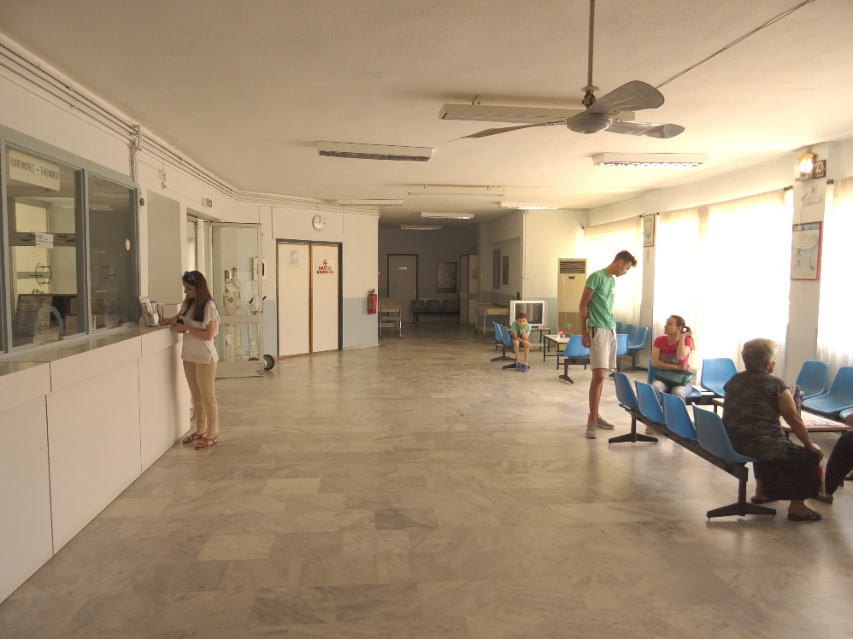
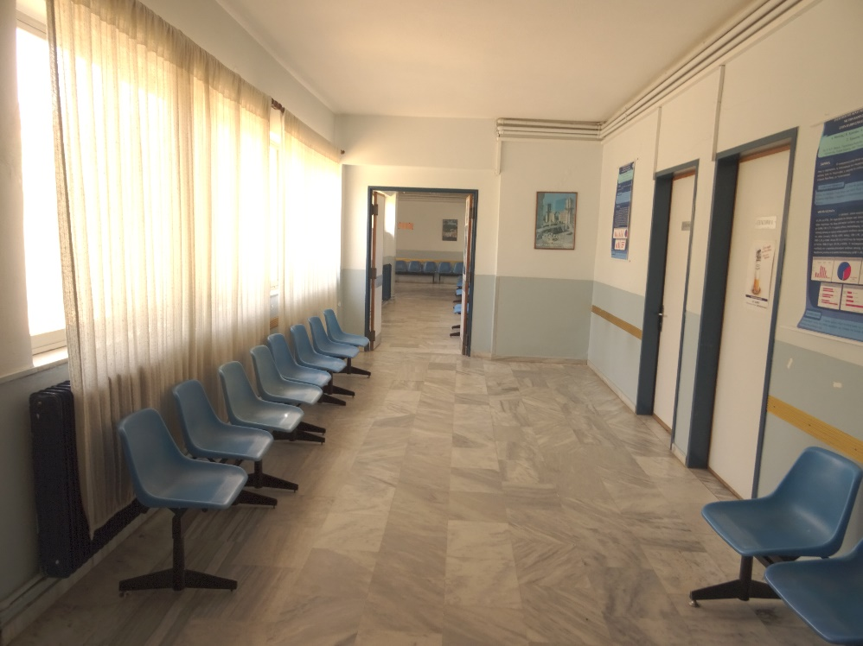
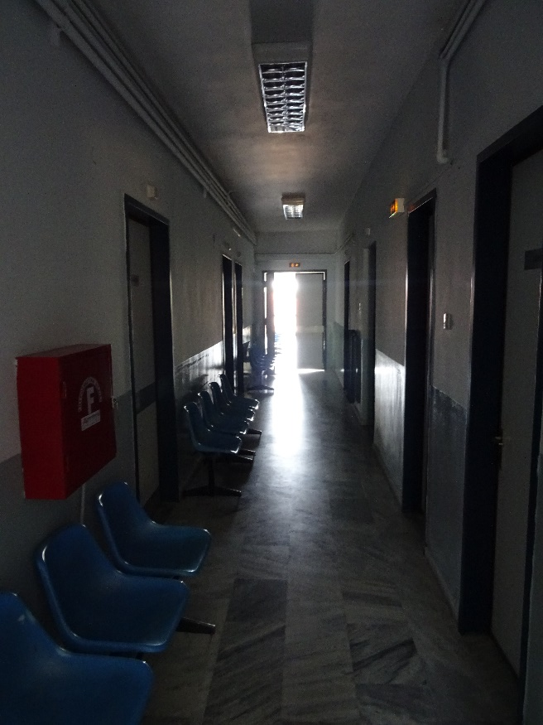
Accessibility evaluation of Iasmos PHC

Slide 20
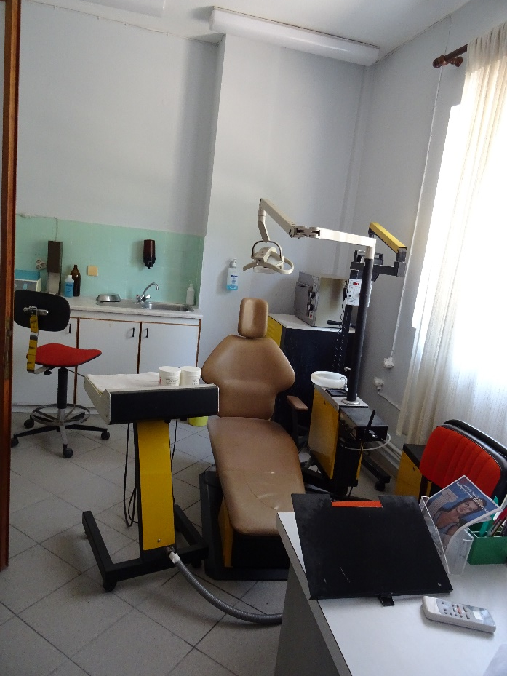
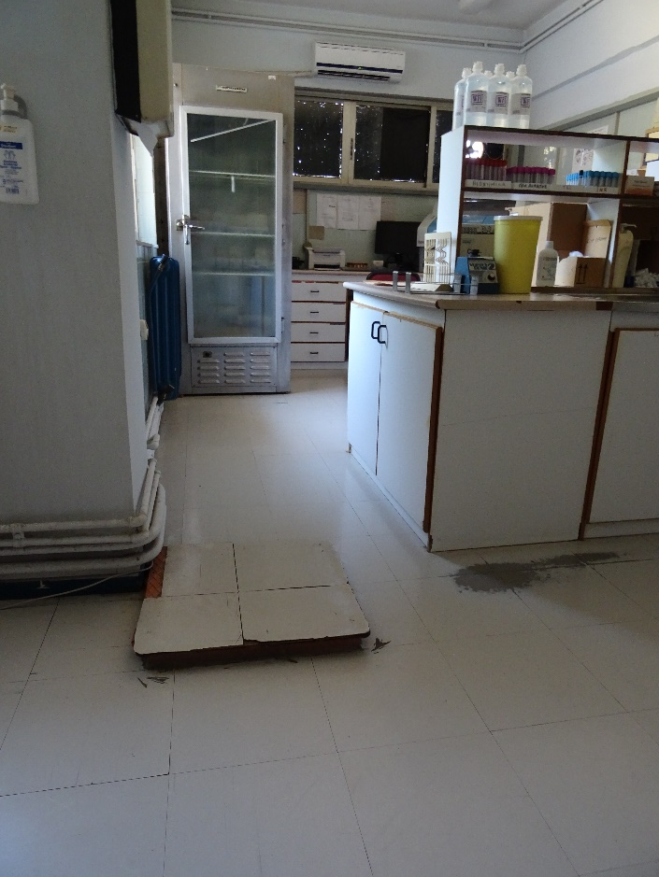
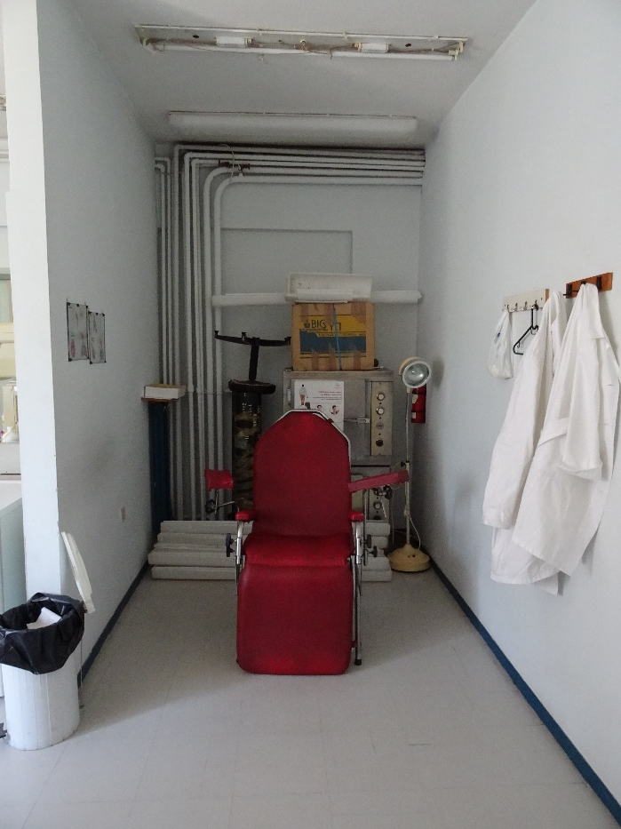
Accessibility evaluation of Iasmos PHC

Slide 21
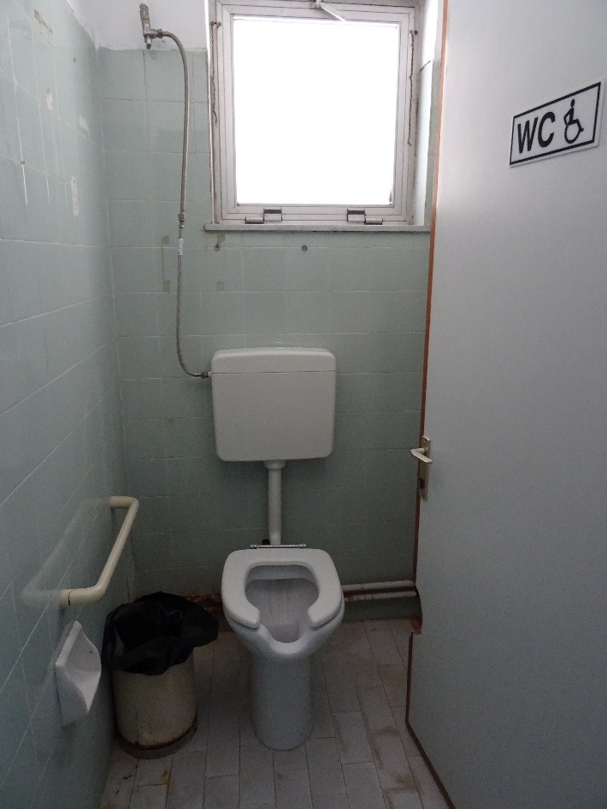
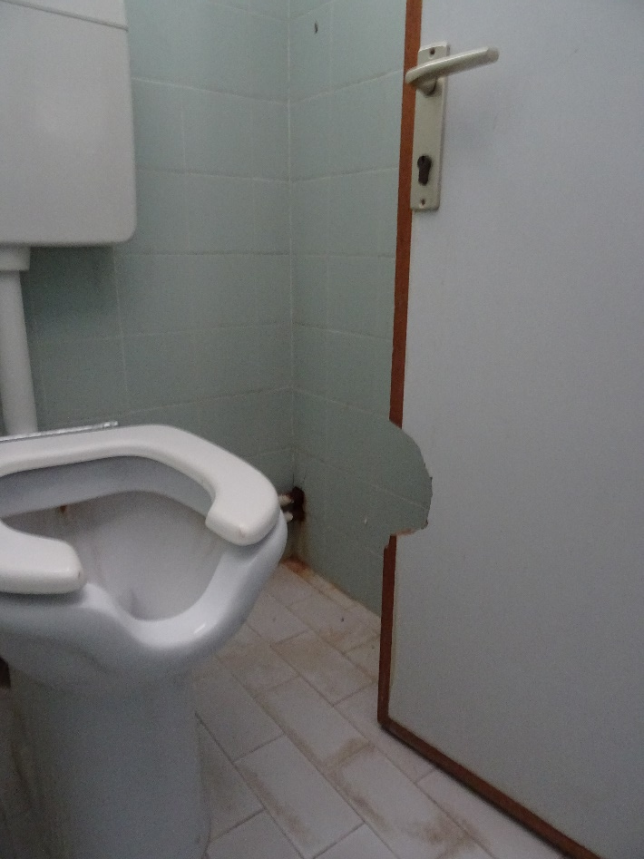
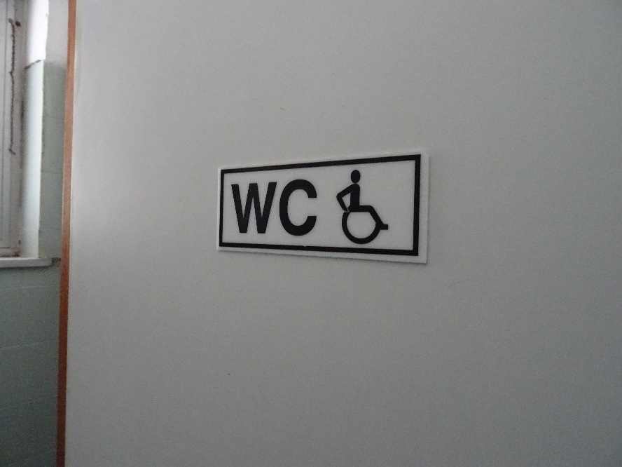
Accessibility evaluation of Iasmos PHC

Slide 22
Accessibility evaluation of Iasmos PHC
Conclusions
The methodology was applied successfully to a small PHC unit
The Iasmos PHC centre offered basic access to disabled visitors
Small scale interventions could lead to marked improvements
The creation of an accessible toilet a major priority
No particular provisions to patients with sensory disabilities

Slide 23
Further actions
D 4.1 Constraints' analysis to access PHC: proposed delivery date – September 2018 (involved PB2 and PB3)
D4.2 Primary Health Care infrastructure accessibility assessment - December 2018 (involved PB2 and PB3)
Interviews with hospital employees?
The assessment methodology for D4.2 will be sent to partners

Slide 24
Thank you
email: naniopou@civil.auth.gr
Tel : +30 2310 995765
www.tsrg.gr

